Slide 1


Project Title :
Project Id : FYP19PID16
Virtual Reality based E-Commerce Web Application
Group Members :
2019-CS-224 Muhammad Ali Mazhar Butt ( Group Leader )
2019-CS-246 Abdullah Rasheed
2019-CS-218 Ehtesham Haider
2019-CS-207 Maham Wajid
Supervisor :
Dr. Amna Zafar
Co-Supervisor :
Mam Farwa Batool
Department of Computer Science
University of Engineering and Technology Lahore

Slide 2
Agenda
Introduction
Related Work
Problem Statement
Scope
Methodology
Technologies Used
Rules & Assumption
Helping Tools
Challenges and Limitations
Project Current Status
Reference

Slide 3
Introduction
We are making a Virtual Reality based E-commerce web application. Our FYP is inspired by the meta verse concept. We are working on four modules that are:
1) Metamart with advanced features
2) 3D Virtual tour of Metamart
3) Virtual Reality based Metamart
4) Based on customer customized inputs system will recommend which size suits best to the user.
Besides this, the customer can see the 3D models, 3D images, and 3D animated avatars in the web application.

Slide 4
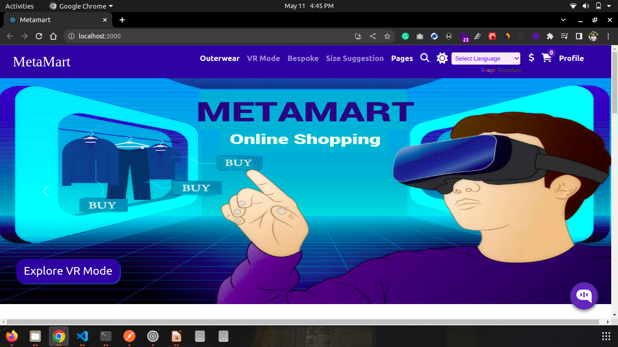
E-commerce website

Slide 5
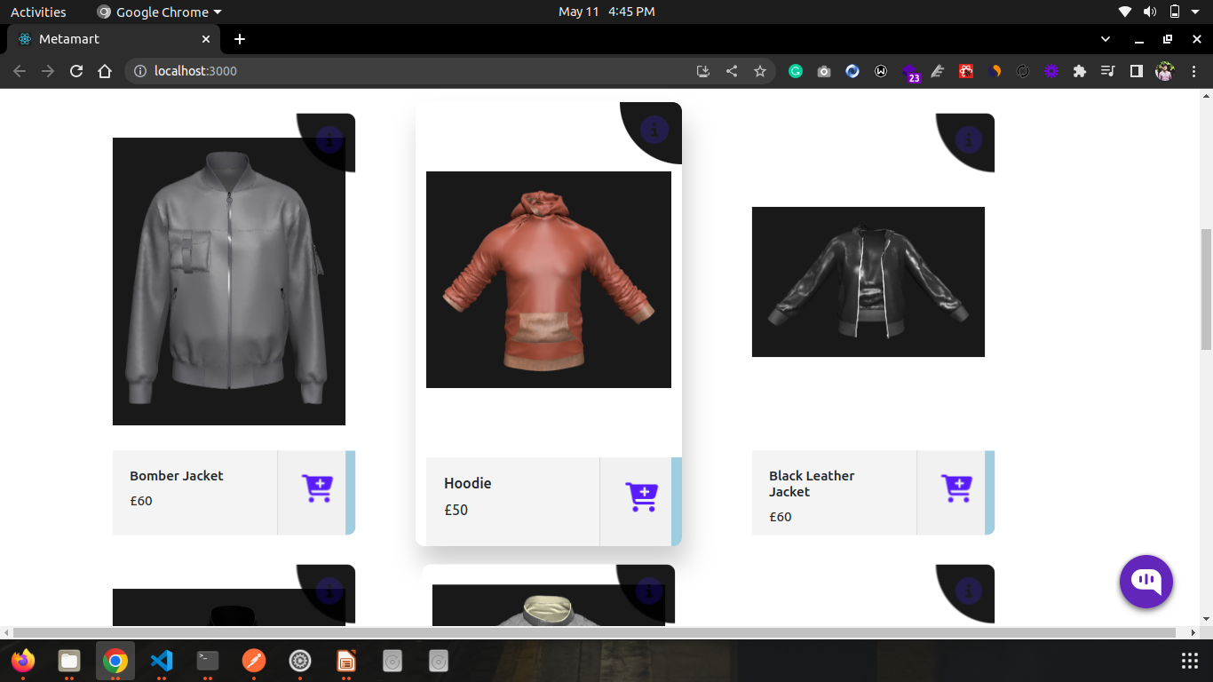
E-commerce website

Slide 6
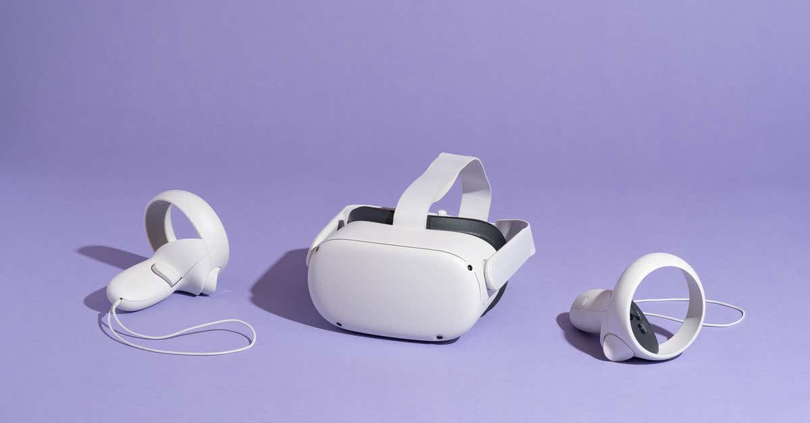
Oculus VR Headset

Slide 7
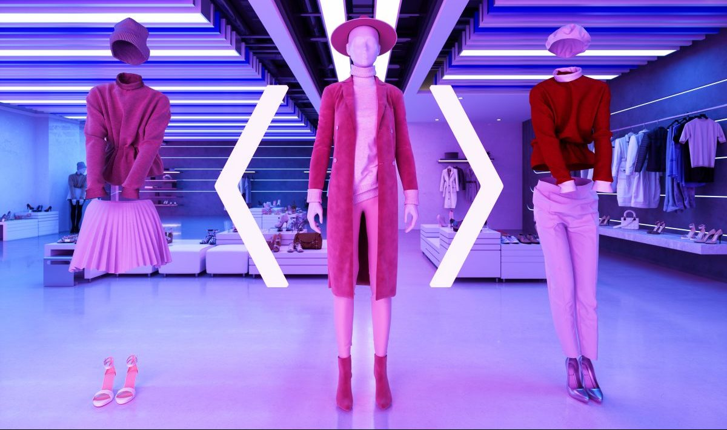

Slide 8
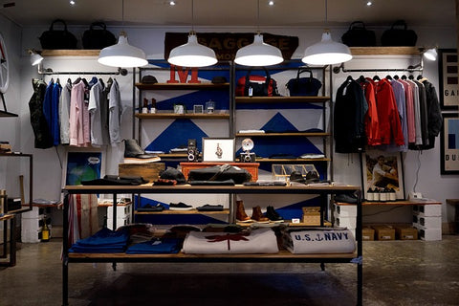
Metamart

Slide 9
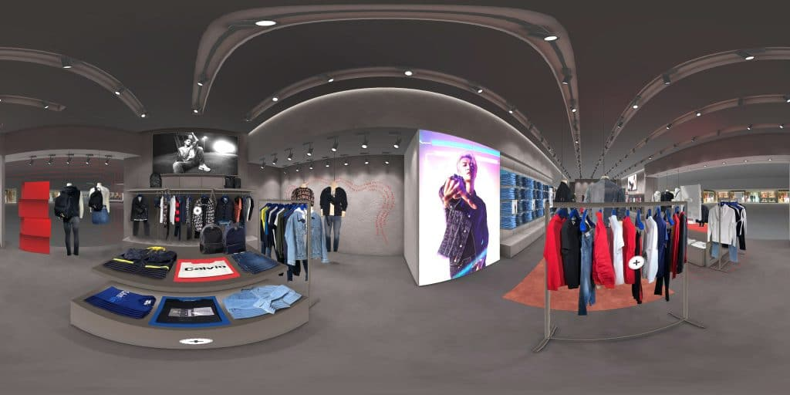
3D Tour of E-commerce Store

Slide 10
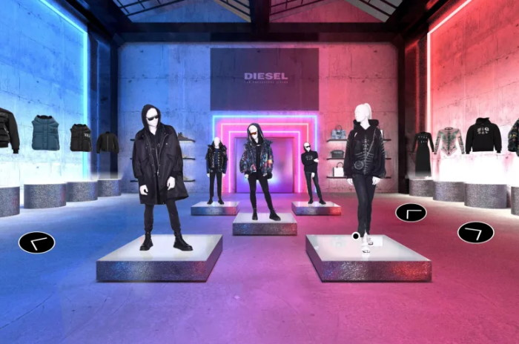
MetaMart

Slide 11
Related Work
In this section, applications that did work on eCommerce applications with VR, AR, and a comparison of different web applications are discussed.

Slide 12
Related Work
 | Name | Category | Status | Function
1 | Yihaodian | AR Store | On-Site | AR stores created on open spaces that give customers the experience of real-world stores in smartphones .[1]
2 | IKEA | Catalog Application | Online | Customers can use AR technology in their smartphones to preview how furniture will look in that surrounding by augmenting furniture objects in real-world. [2]
3 | Lacoste | LCST Augmented Reality Retail Campaign | Online | Customers can try different shoes [3]
4 | Audi | VR-Based Application | On-Site | Passengers traveling with a driver and feeling bored can experience amusing 3D environments configured with real-world vehicle speed, and bumps on the road in the real world by wearing VR headsets provided by AUDI .[4]
5 | Converse | Shoe Sampler | Online | Customers can try shoes by using AR-based applications.[5]
6 | Topshop | AR Mirror | In-Store | Customers can try-on outfits in-store by using AR change room. [6]

Slide 13
Related Work
 | Name | Category | Status | Function
7 | Sephora | AR-based application | Online | Customers can get virtual makeup and try different shades by using Sephora virtual assist in their mobile phones. [7]
8 | L’Oréal | AR based application | Online | Customers can try out all L’Or´eal products by using virtual makeovers and can try different beauty trends on their mobile phones, and tablets. [8]
9 | Burberry | Virtual Store | Online | Customers will experience the virtual store by navigating through the 3D store environment and would be selecting products by selecting digital icons in the environment. [9]
10 | Mister Spex | Virtual Mirror | Online | Customers can try different frames of glasses virtually using AR-based applications and can find his/her favorite model. [10]
11 | Timber Land | AR Magic mirror | In-Store | Customers can tryout different outfits by standing in front of their avatar in mirror screen . [11]
12 | Uniqlo | AR Mirror | In-Store | Customers can try different colors of a single cloth product by just wearing that single product in front of an AR-based mirror called “magical mirror”. [12]
13 | Gapinc | AR based application | Online | Customers can virtually try on clothes using an AR app called Dressing Room by GAP. [13]

Slide 14
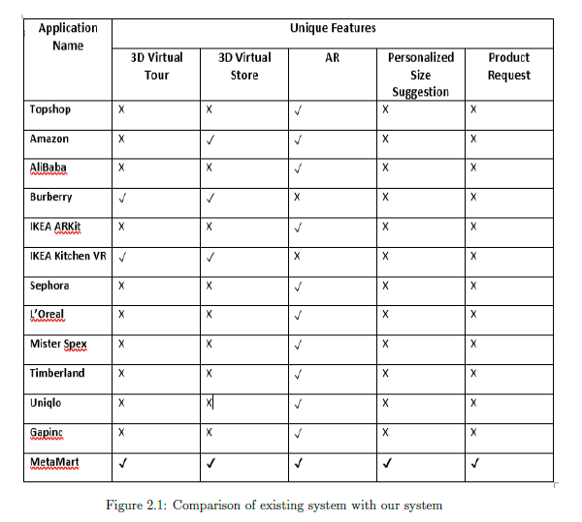

Comparison table of existing system with our system
X

Slide 15
Research Work
 | Research Paper Name | Description
1 | The rise of 3D ECommerce: the online Shopping gets real with virtual Reality and augmented Reality During COVID- 19 | • COVID-19 has affected business field. All physical businesses are trying to shift towards online business. • As E-commerce websites provide a well professional 2D website for online shopping but this is not enough for user. • User must get the experience of physical world (real world). So that they can make good choice and can get better experience. • AR and VR technology increase customer satisfaction. • User can get more precise information using AR and VR technologies. • User experience is enhanced by an AR assistant that provides user with all the required information in audio form or using avatar.[16]
2 | Multi-Dimensional Interface Design of E-Commerce for Virtual Museum System | This research paper focused on interface design of virtual museum system. Paper suggested that interface design can be displayed in multi dimensions. 2D view was good but not good enough as all the images of antiques are display in 2D in front of user. Navigation was difficult to human cognitive. In order to make system productive, panorama functionality was used. VR technology was used that make user able to walk through the museum. They provided functionality of zooming to users. Result of this implementation was that information presented using VR and panorama technology was more effective as compared to 2D images. This increased usability of system.[17]

Slide 16
Research Work
 | Research Paper Name | Description
3 | A Free Virtual Reality Experience to Prepare Pediatric Patients for Magnetic Resonance Imaging: Cross-Sectional Questionnaire Study | A magnetic resonance image (MRI) is a test which require patients to lie still until the test is done. MRI is difficult for children to tolerate. So doctors use general anesthetic (GA) to ensure patient safety. So this paper was written to make VR resource that can be used to prepare patients for MRI by reducing their anxieties about MRI process. This resource was consist of an app with preparation book. This app used 360 degree videos of MRI machine to create a real world simulation so that patients could be prepared for the real MRI test. At the end VR resource was smart enough for educating patients about MRI process.[18]
4 | Virtual Reality as an Educational and Training Tool for Medicine | There are two general classifications of Virtual reality. First one is that in which we visualized real world using 3D technologies like Unity. Second one is that which is reflection of reality, the type of VR classification created using spherical or 360 images or videos. This research paper explains both the systems. Technologies used for these systems are Cardboard SDK and Gear VR SDK. Cardboard SDK is used to create systems for wide range of glasses and devices. Gear VR SDK is used to create virtual experience for Gear VR For 360 content system Samsung gear 360 camera was used. [19]

Slide 17
Problem Statement
To bridge the gap between physical and digital worlds, a virtual reality based Metamart that would provide immersive and realistic experience to customers through the concepts and technologies of the Metaverse.

Slide 18
Scope of the Project
Currently this application is limited to E-Commerce but this web application can be extended for virtual reality-based healthcare and educational systems etc.

Slide 19
Methodology

Slide 20
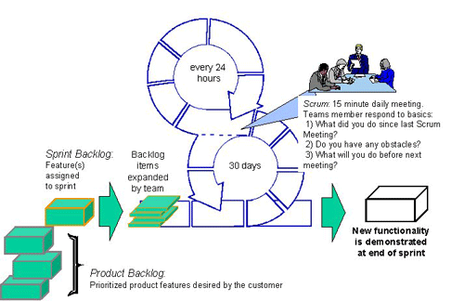
Software Development Approach
For the development process, we followed the agile methodology in which we designed weekly sprints.
During the sprint planning meeting, the highest priority features have to be worked on within the time.

Slide 21
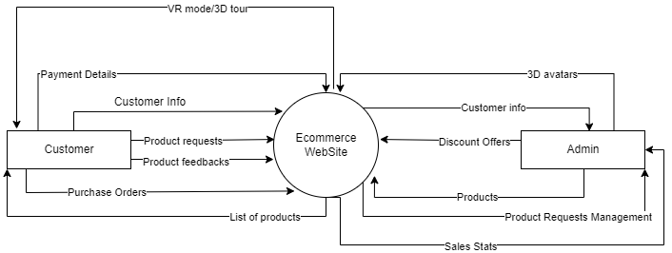
General Proposed Diagram

Slide 22

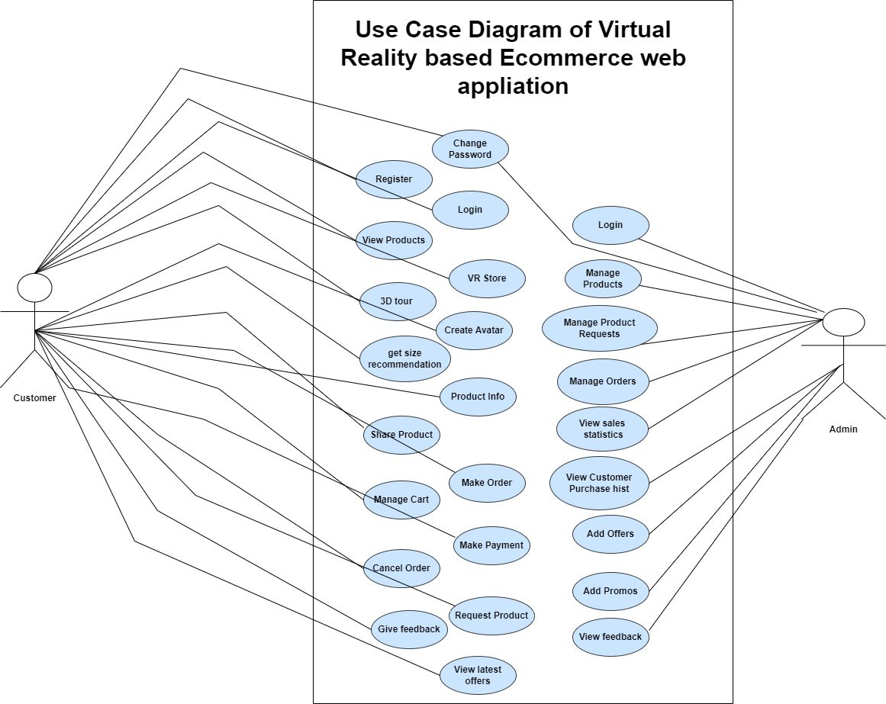


Use Case General Diagram

Slide 23
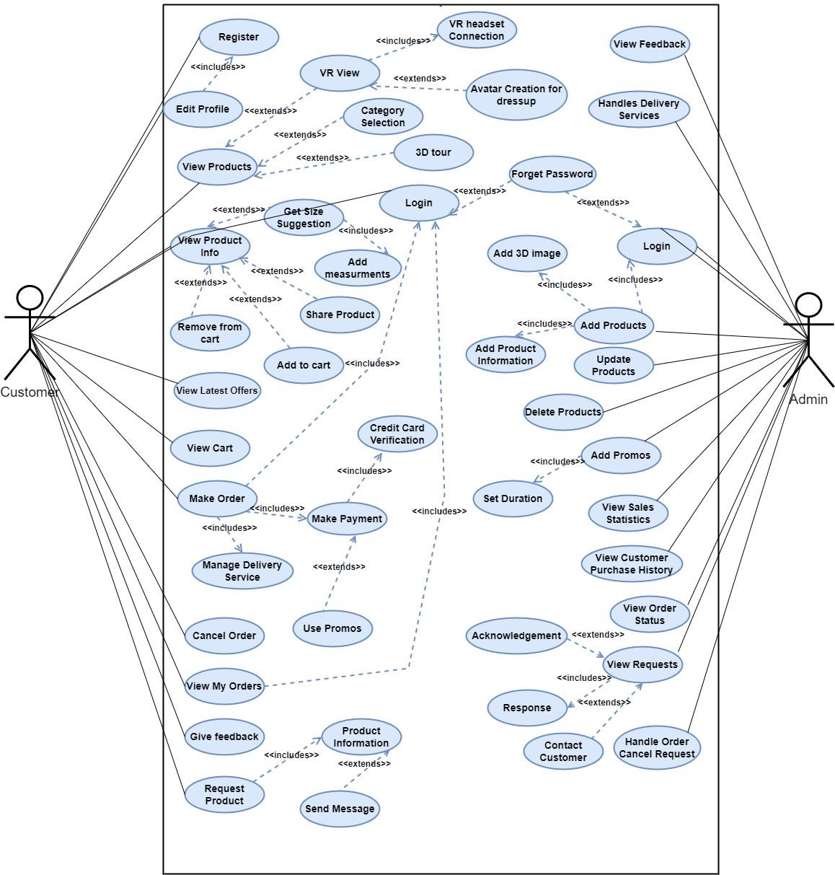
Use Case Detailed Diagram

Slide 24
Technologies
For Web Development
HTML
CSS
Boostrap5
JavaScript
React
Express
MongoDB
NodeJS
For Virtual Environment
Unity with C#

Slide 25
Rules & Assumptions
Rules and cases of assumptions that are assumed to be true while experiencing virtual reality mode working:
The customer has an Oculus VR headset and the configurations/setting for Oculus
VR Headset is also done by the customer before going into VR mode.
Rules and cases of assumptions that are assumed to be true while normally
working:
The internet connection is stable.

Slide 26
Helping Tools
Make Human ( For making 3D Avatars )
Clo3D ( For making 3D Jackets )
Git ( For Source Code Management )
Asana ( For Task Management )
Balsamiq ( For making Wireframes )
Zoom ( Communication Platform )
Latex ( For Documentation )
Unity ( For making 3D virtual environment )

Slide 27
Challenges & Limitations

Slide 28
Challenges
VR Headset Cost
Integration of the Web and Unity Environment
Creation of the customized fittings for virtual avatars
Understanding of the Payment API
Understanding of the Delivery Method

Slide 29
Limitations
Avatars with custom inputs of users cannot be made at runtime
Without VR Headset customer cannot experience VR Mode

Slide 30
Project Status
Diagrams
Documents
SRS
Feasibility Study
Literature Survey
Use Cases
Functional Requirements
Non Functional Requirements
Test Case Scenarios
Acceptance Criteria for User Stories
Class Diagram
ERD
Use Case Diagram( General )
Use Case Diagram ( Detailed )
Sequence Diagram
Flow Chart
Data Flow Diagram( Level 0 )
Data Flow Diagram ( Level 1)
Architectural Diagram

Slide 31
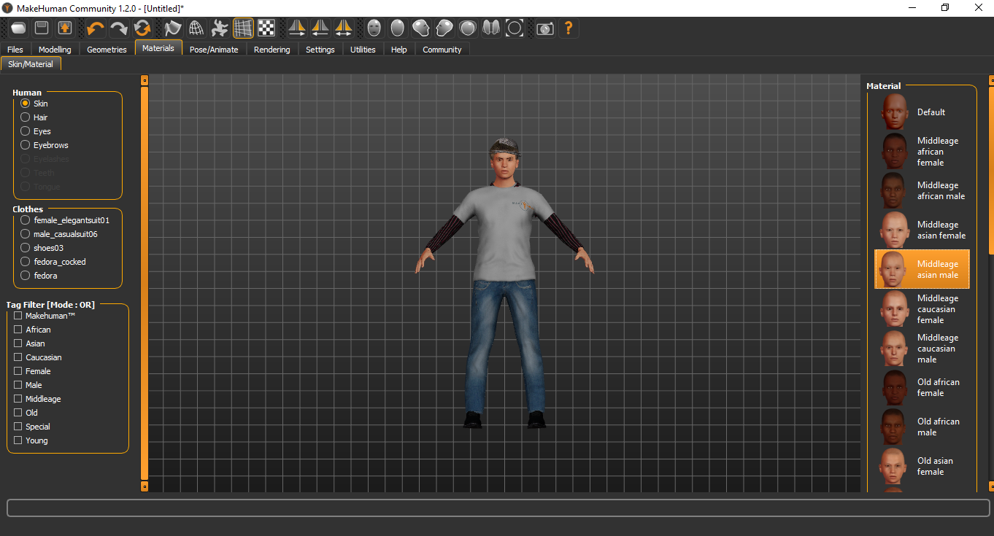
Make-Human

Slide 32
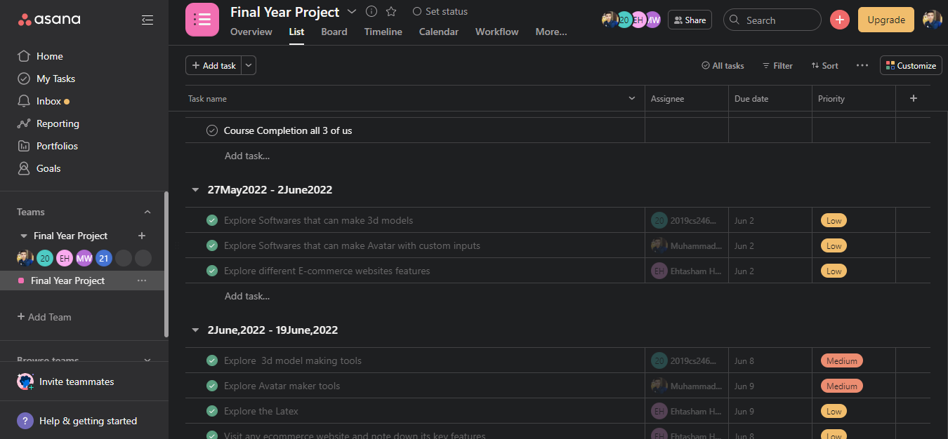
Asana

Slide 33
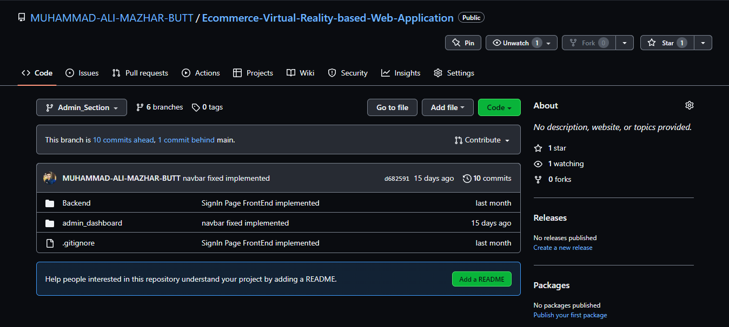
Github

Slide 34
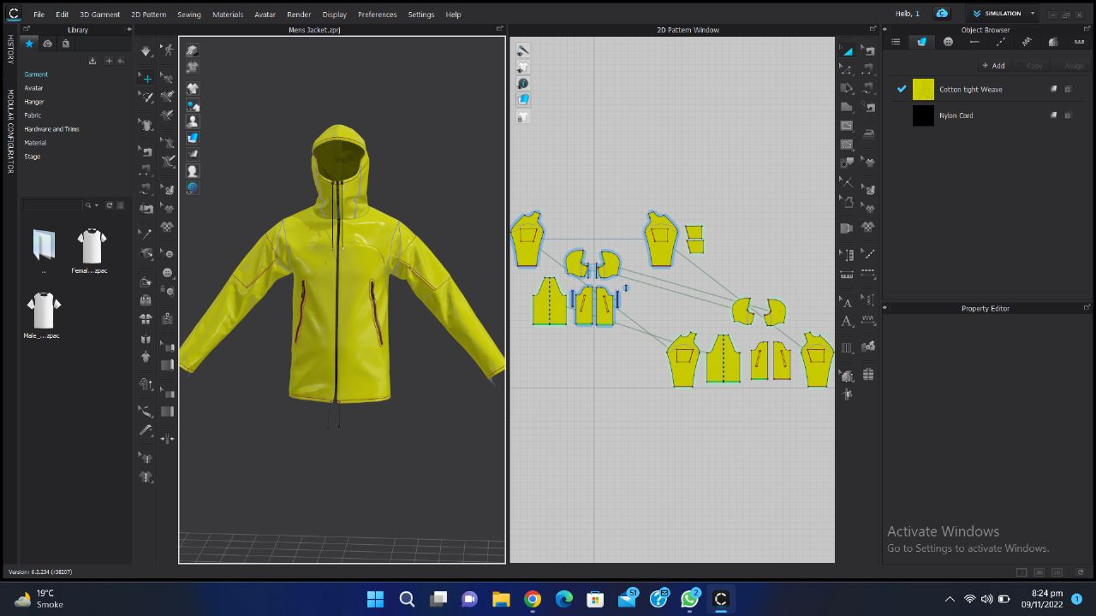
Clo3D

Slide 35
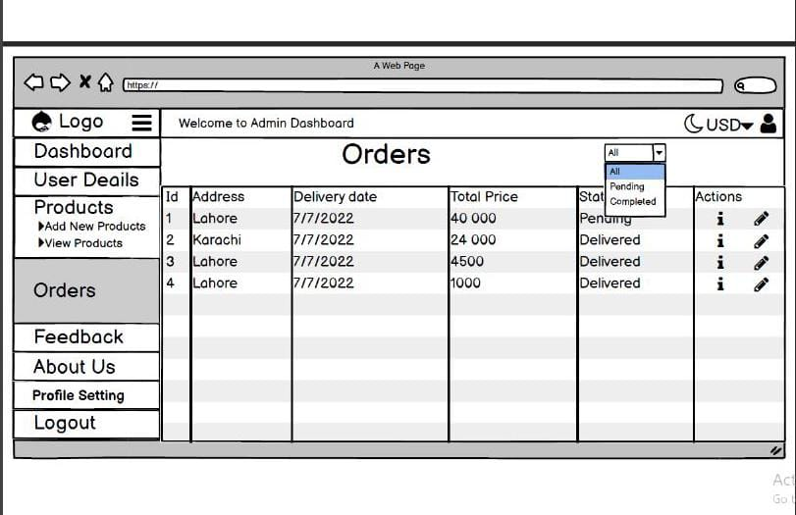
Balsamiq

Slide 36
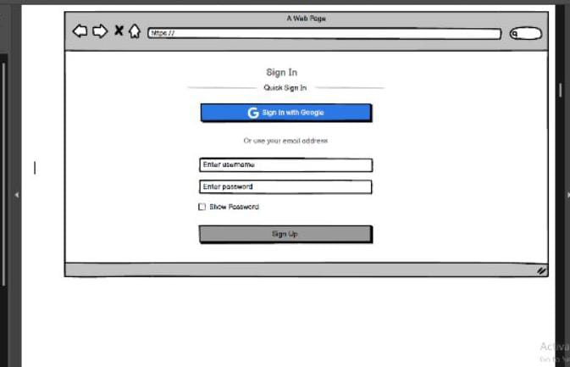
Balsamiq

Slide 37
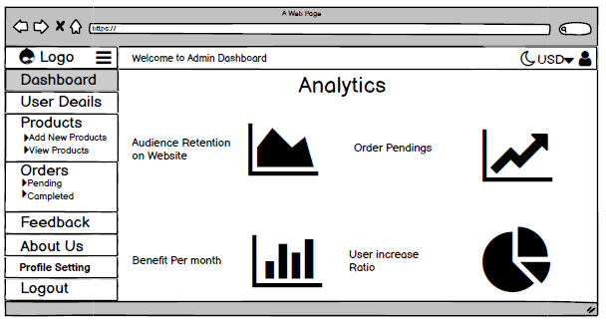

Slide 38
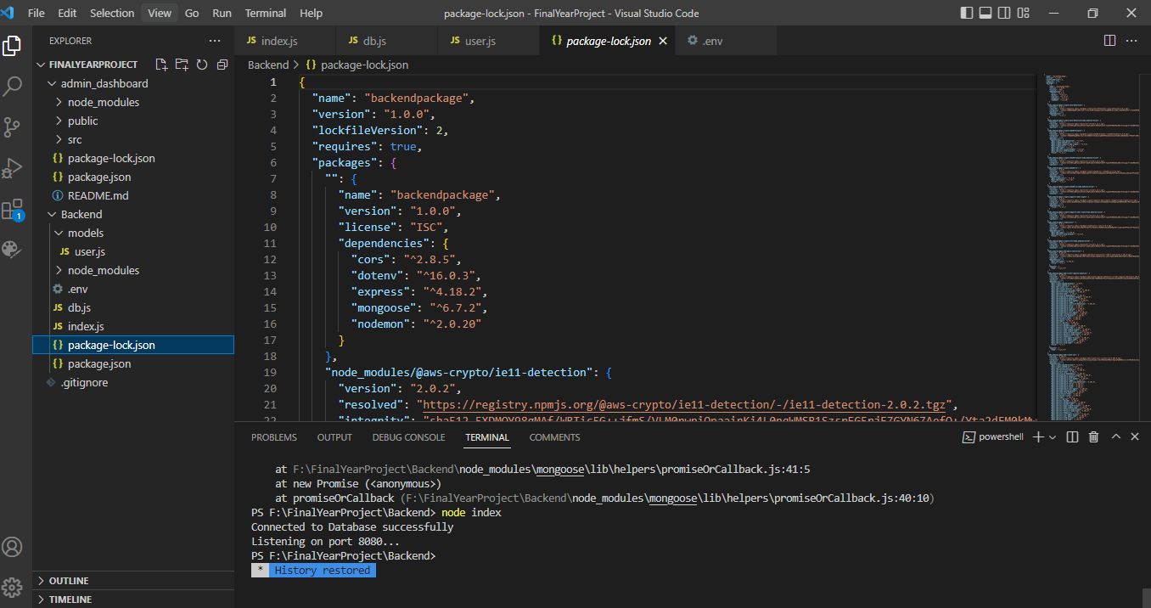
VS Code

Slide 39
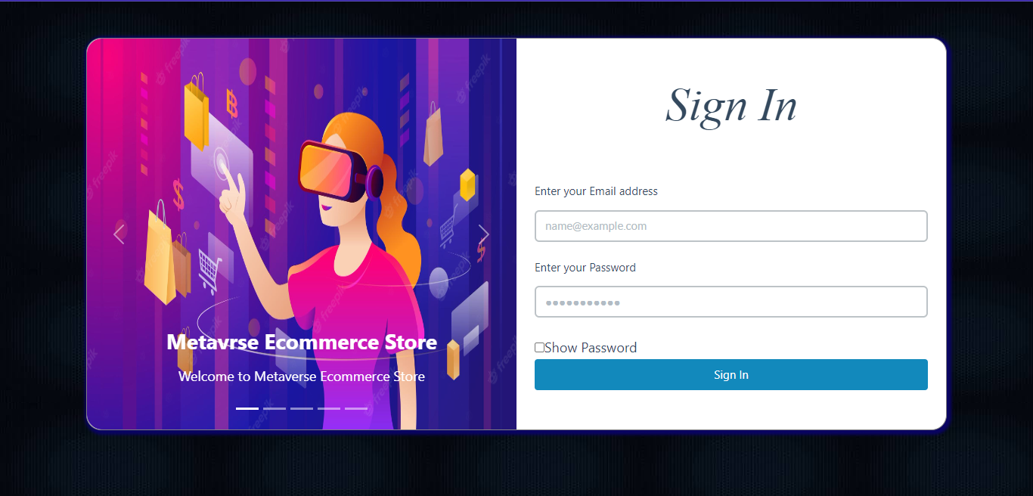
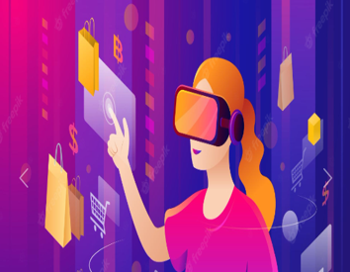
Welcome to Metamart

Slide 41
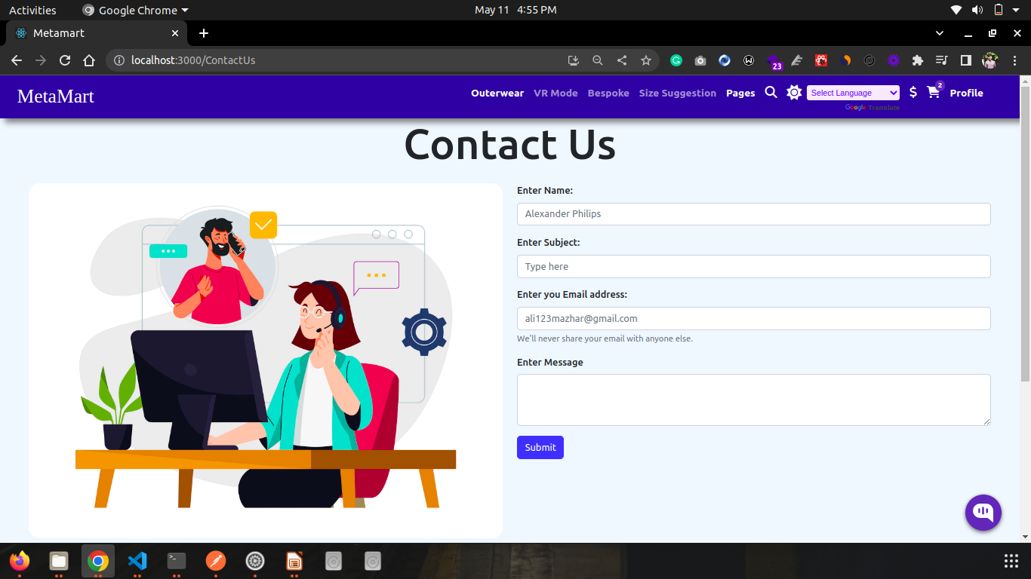

Slide 42
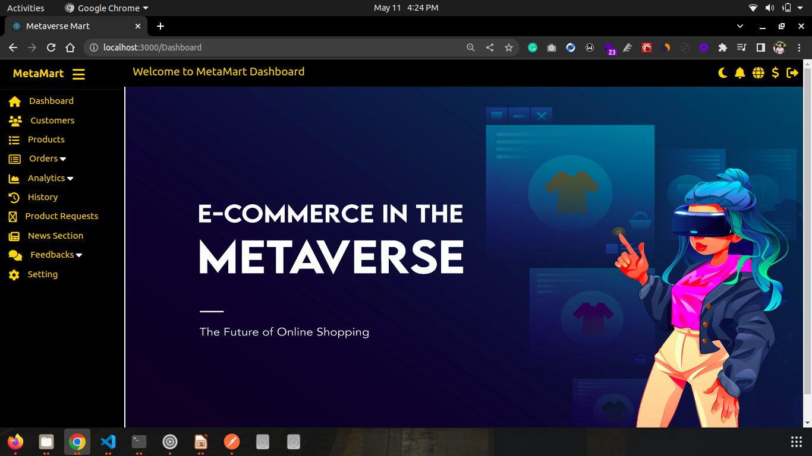

Slide 43
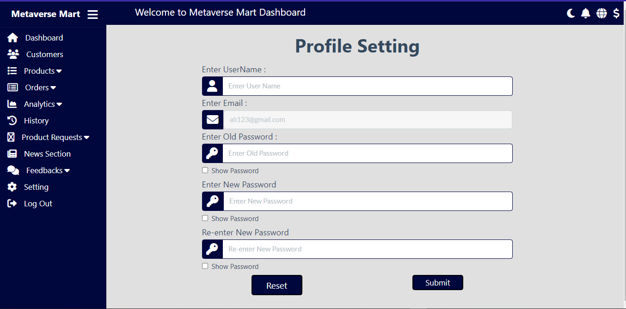
Admin Section

Slide 44
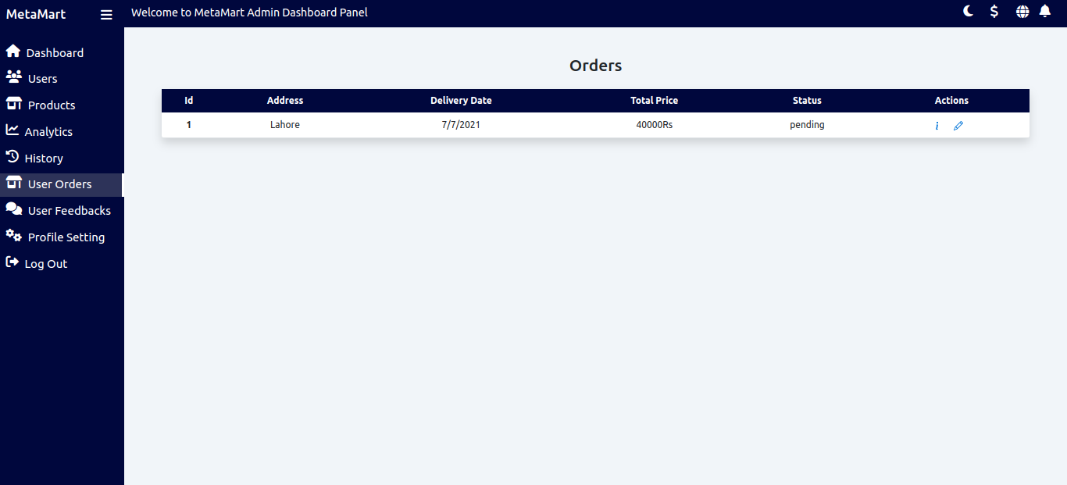
Admin Section

Slide 45
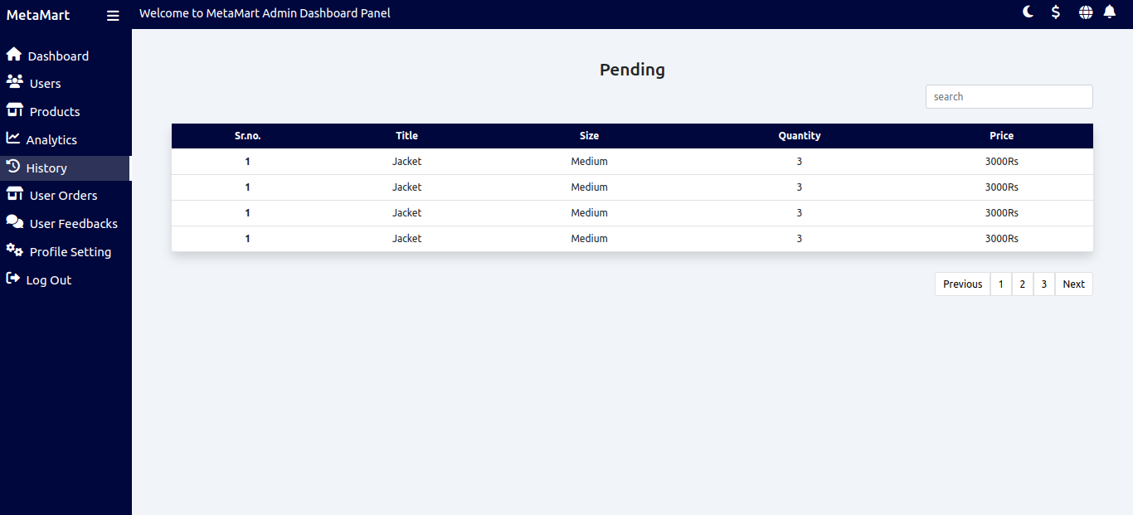
Admin Section

Slide 46
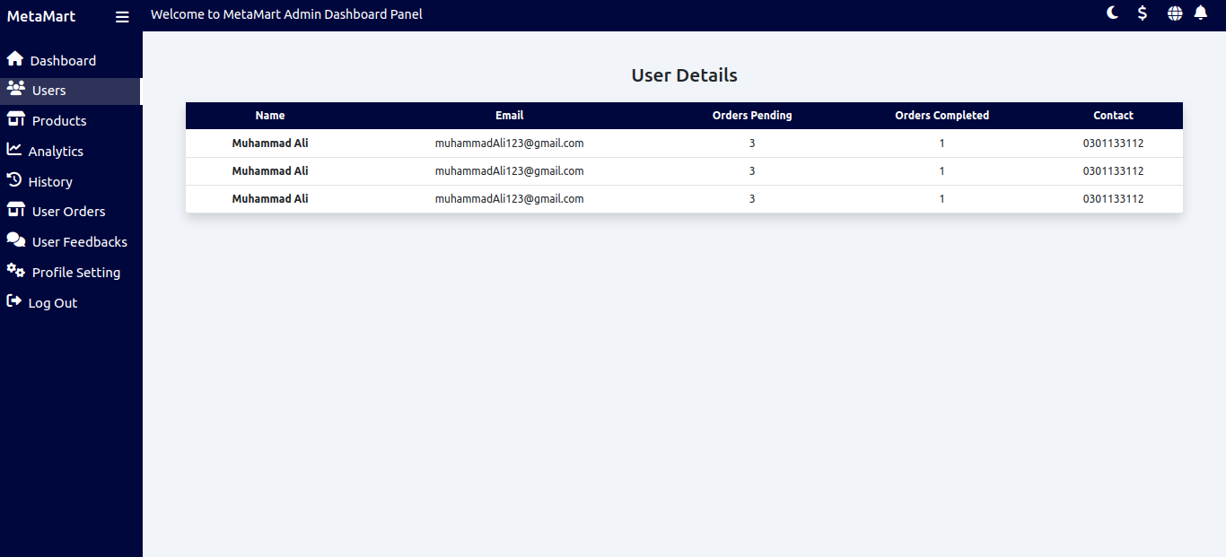
Admin Section

Slide 47
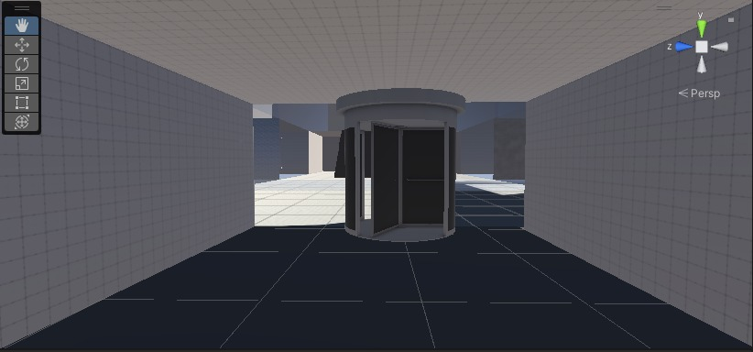
Entrance of MetaMart

Slide 48
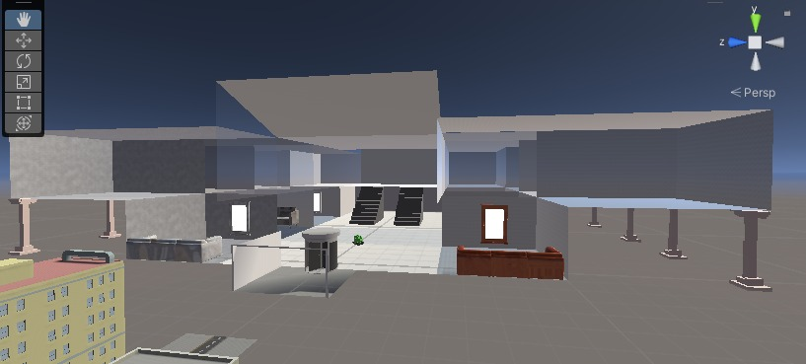
MetaMart view from Outside

Slide 49
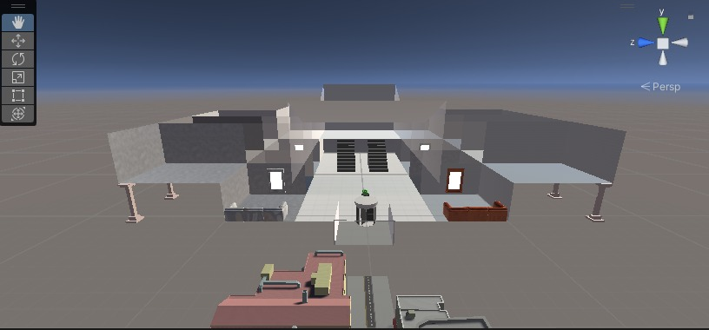
Front View of MetaMart

Slide 50
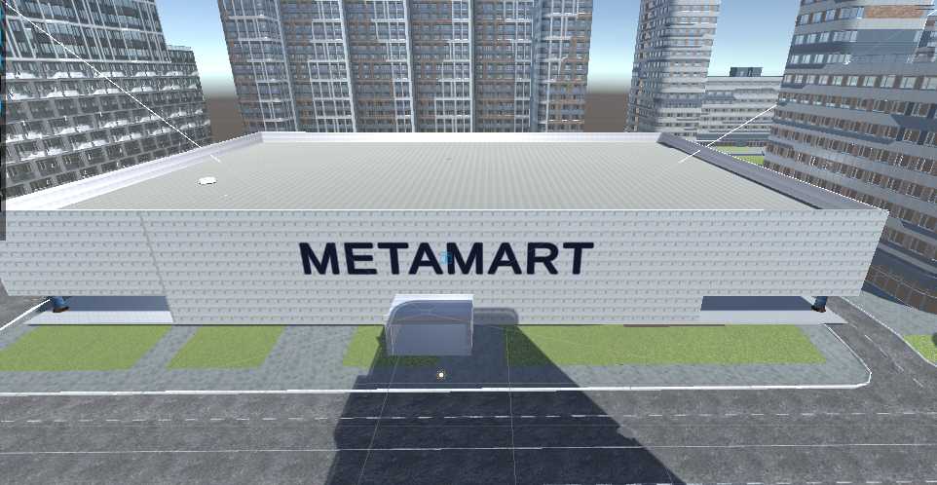

Slide 51
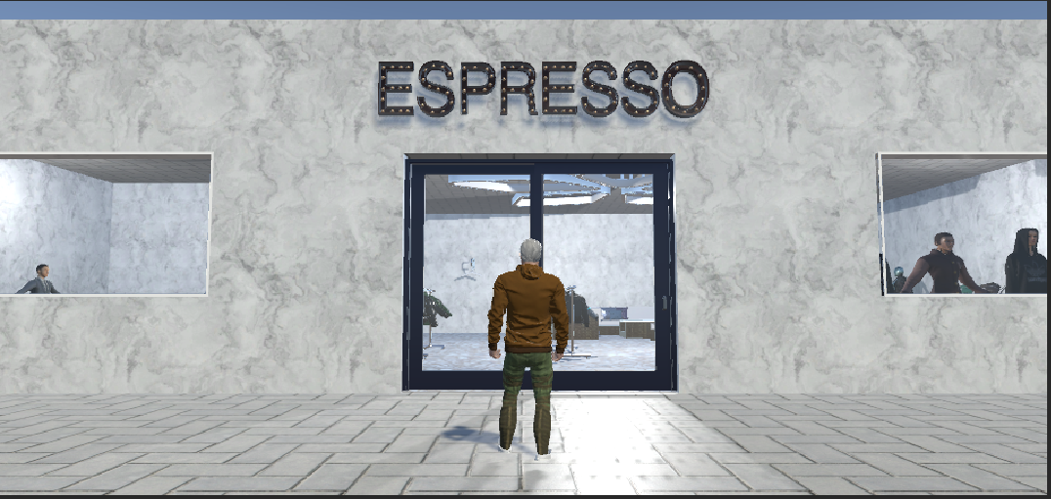

Slide 52
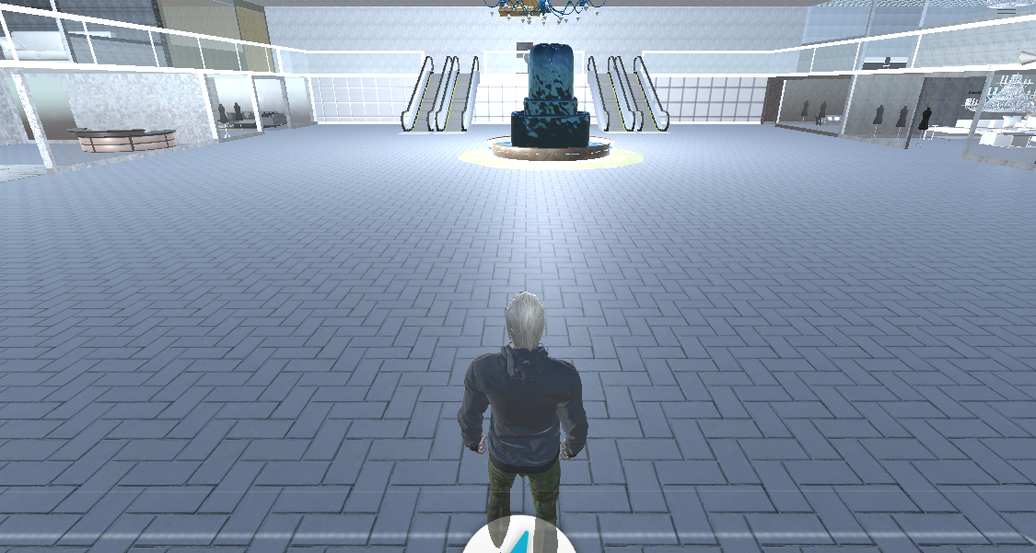

Slide 53
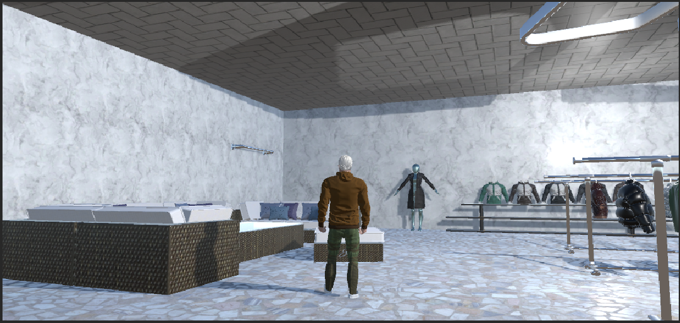

Slide 54
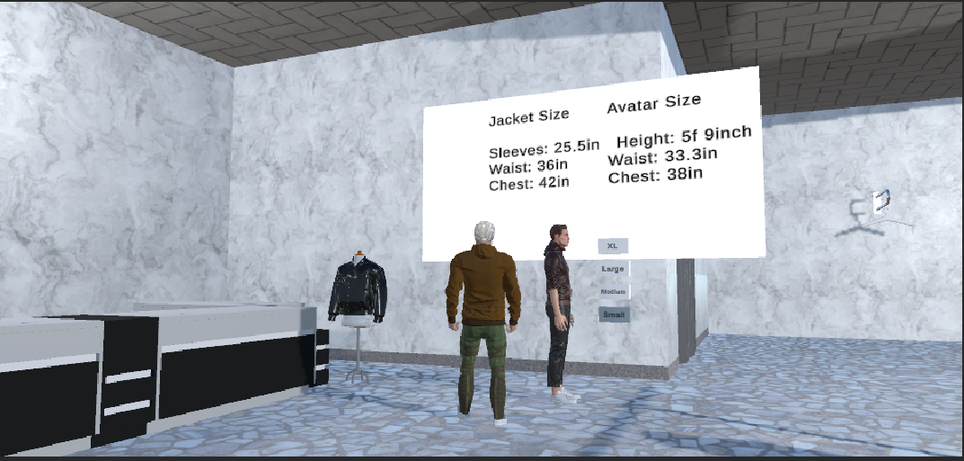

Slide 55
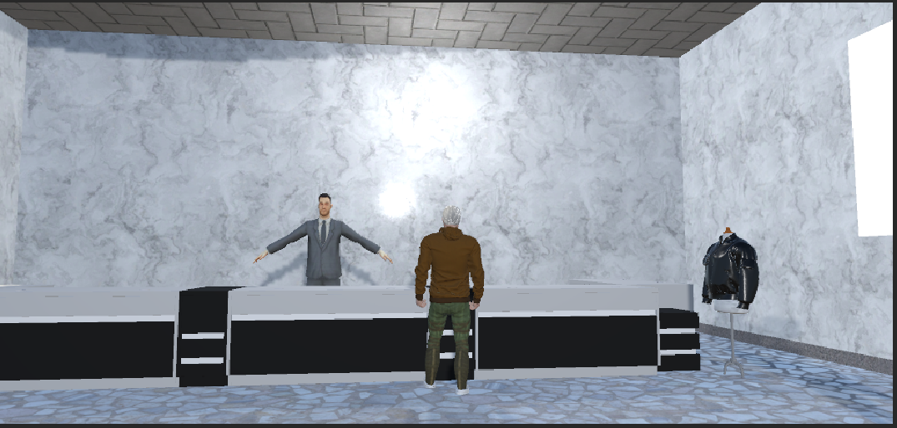

Slide 57
References
[1] SprintWise, “Vr stores turn open spaces into a supermarket,” Available at https://www.springwise.com/in-china-virtual-reality-stores-turn-open-spaces-supermarket/ (2013/01/14).
[2] S. Joseph, “How ikea is using augmented reality,” Available at https://digiday.com/media/ikea-using- augmented-reality/ (2017/10/4).
[3] S. Vizard, “Lacoste takes stores digital with AR app for new trainer range,” Available at https://www.marketingweek.com/lacoste-takes-stores-digital-with-ar-app-for-new-trainer-range/ (2014/07/21).
[4][5] Arvar, “Converse: an augmented reality app for trying on shoes,” Available at https://arvar.org/en/cases/converse-an-augmented-reality-app-for-trying-on-shoes/(2020/03/03).
[6] C. Foy, “Topshop Kinect allows the users to try clothes on sans change rooms,” Available at https://www.trendhunter.com/trends/topshop-kinect/ (2011/05/13).
[7] Sephora, “Sephora virtual artist,” Available at https://www.sephora.my/pages/virtual-artist/.
[8] “How augmented reality is revolutionizing the beauty experience,” Available at https://www.loreal- finance.com/en/annual-report-2017/digital/augmented-reality-beauty-experience (2017).

Slide 58
References
[9] “Burberry to launch virtual store in partnership with elle digitaljapan,” Available at https://www.burberryplc.com/en/news/brand/2021/burberry-to-launch-virtual-store-in-partnership with-elle-digita.html(2021/03/19)
[10] “Try glasses on virtually,” Available at https://www.misterspex.co.uk/l/pg/100508/- (2022/04)
[11] Arvar, “Fitting clothes in AR format by timberland,” Available at https://arvar.org/en/cases/fitting- clothes-in-ar-format-from-timberland/ (2022).
[12] T. Millar, “The Uniqlo magic mirror virtually changes the colors of clothes,” Avail-able at https://www.trendhunter.com/trends/uniqlo-magic-mirror (2012/10/22).
[13] L. Nunon, “Gap tests new virtual dressing room,” Available at https://www.gapinc.com/en- us/articles/2017/01/gap-tests-new-virtual-dressing-room (2017/01/04).
[14] V. S. D. A. A. S. M. A. K. G. Satish Rupraoji Billewar, Karuna Jadhav and D. N.K. K. Bhasin, “The rise of 3d e-commerce: online shopping gets real with virtual reality and augmented reality during covid-19,” World Journal of Engineering, vol. 19, no. 2, pp. 244–253, 2022.
[15] H. M. N. S. A. Tengku Siti Meriam Tengku Wook, Siti Fadzilah Mat Nor and N. A. M. Zin, “Multi- dimensional interface design of e-commerce for virtual museum system,” International Journal on Advanced Science Engineering InformationTechnology, vol. 10, no. 2, 2020.

Slide 59
References
[16] K. W. E. S. A. S. M. S. L. C. Jonathan Ashmore, Jerome Di Pietro and C. Mc-Grath, “A free virtual reality experience to prepare pediatric patients for magnetic-resonance imaging: Cross-sectional questionnaire study,” JMIR Pediatrics and Parenting, vol. 2, no. 1, 2019.
[17] F. J. G. P. J. M. G. M. J. S. L. Santiago Gonzalez Izard, Juan A. Juanes and P. Ruisoto, “Virtual reality as an educational and training tool for medicine,” Journal of Medical Systems, vol. 42, no. 50, 2018.

Slide 60


